Slide 1
Graph DB
Lift and Shift
October 19, 2018
KROLL BOND RATING AGENCY, INC

Slide 2

Cloud

Slide 3
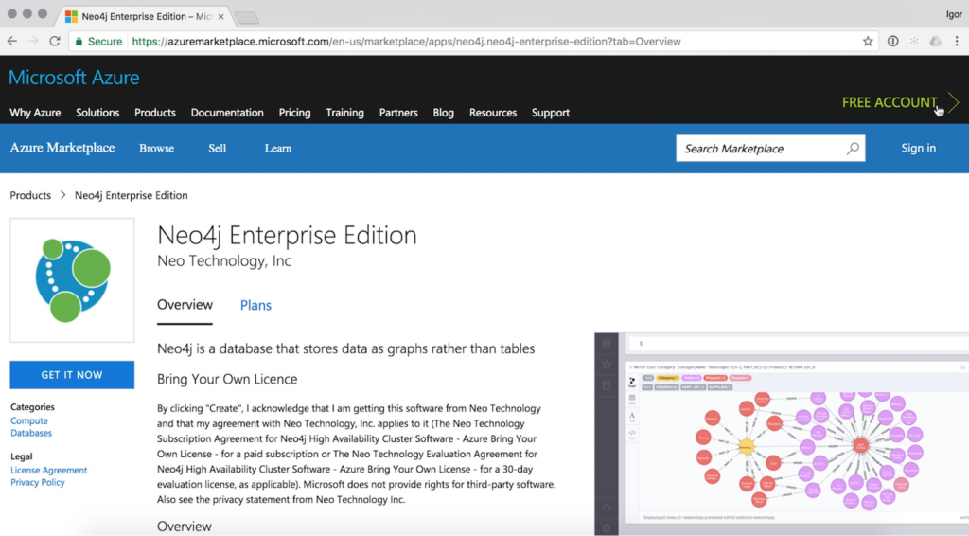
Azure

Slide 4
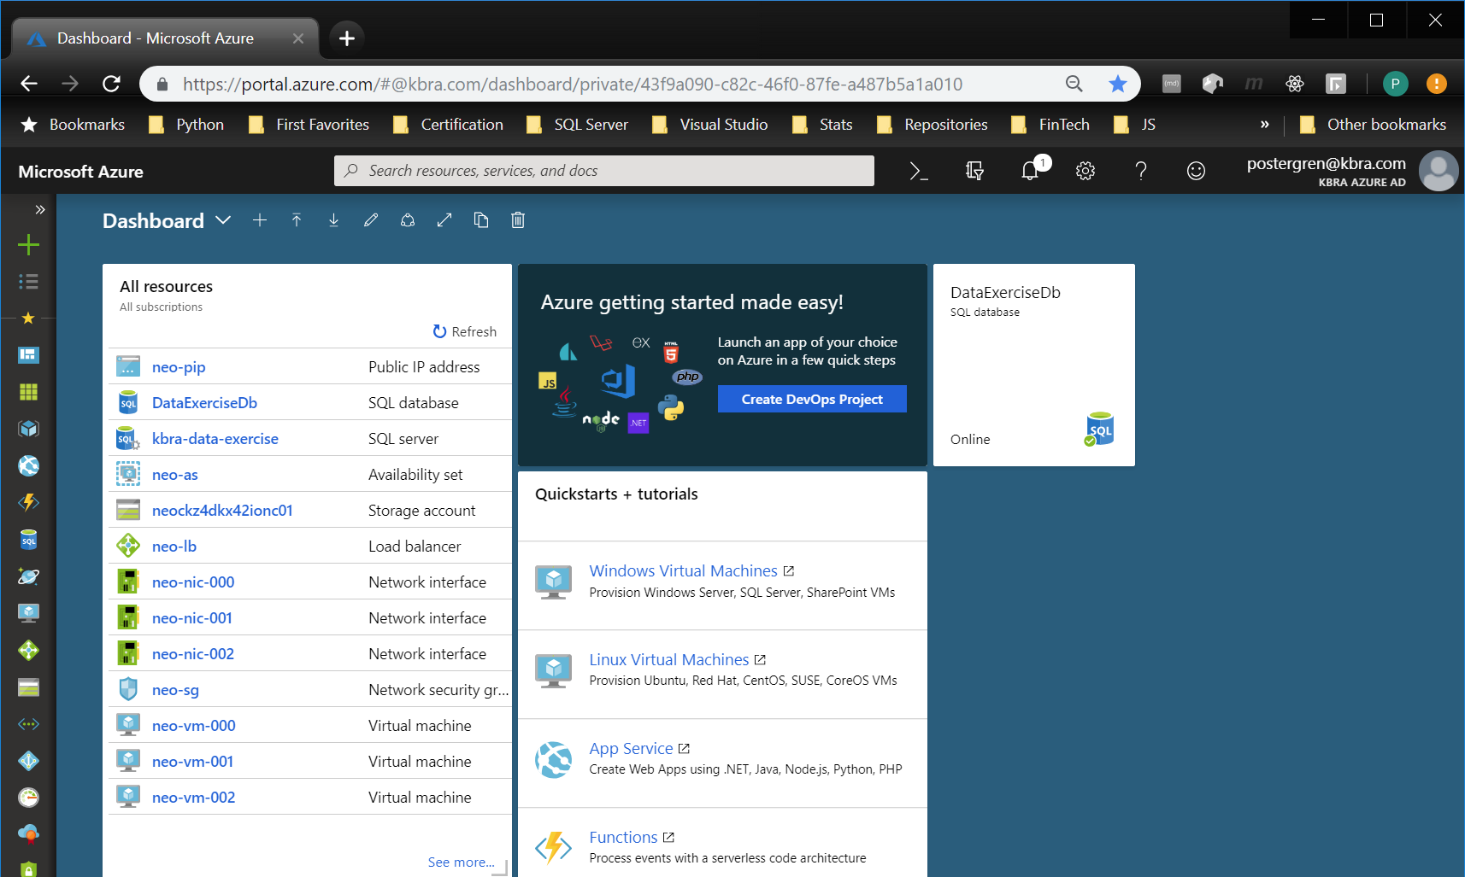
Azure

Slide 5
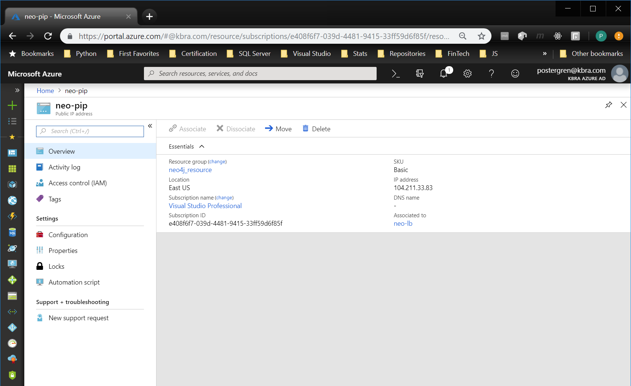
Azure

Slide 6
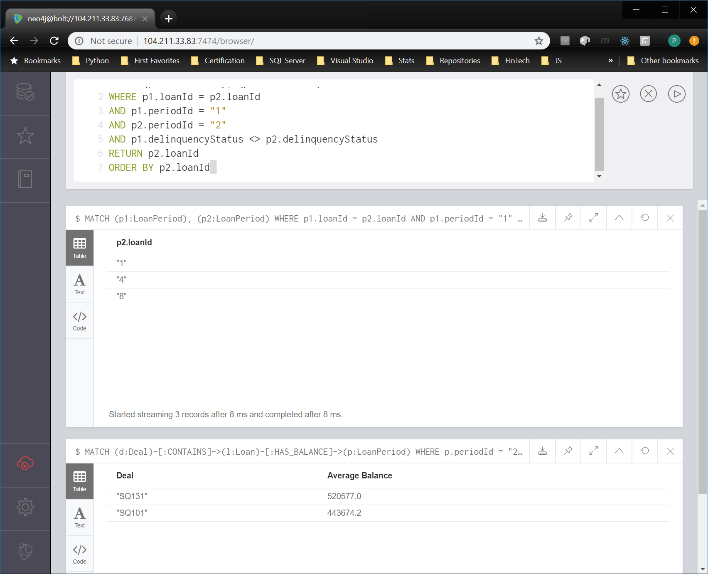
Not Localhost

Slide 7
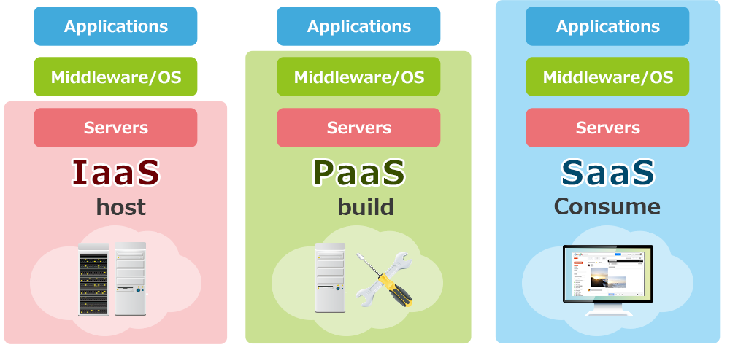
The Shift

Slide 8
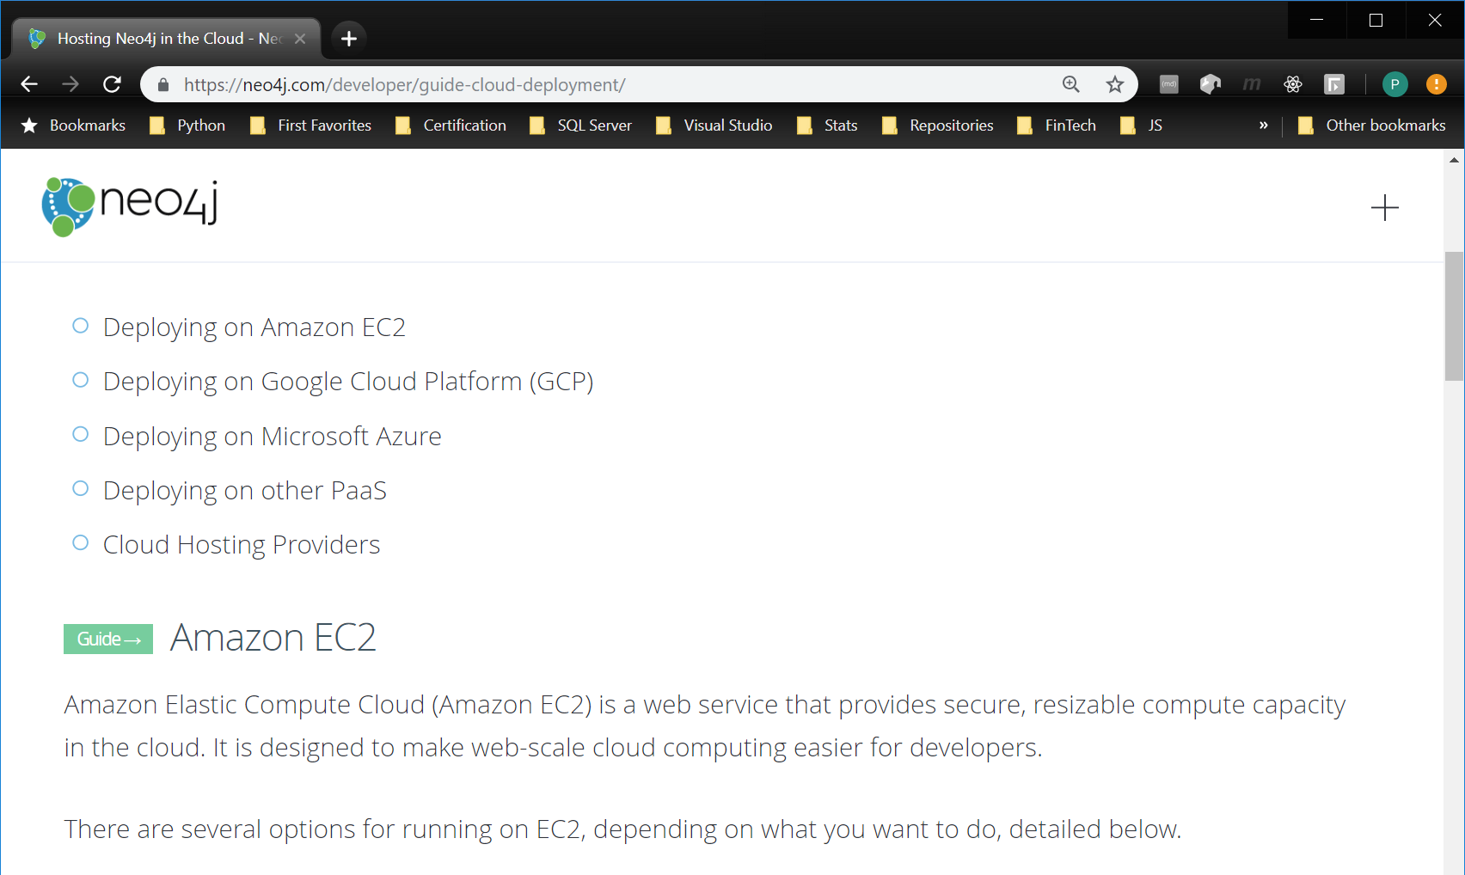
The Shift

